Slide 1
Topic 3
Web app development with php Laravel MVC framework

Slide 2
Contents
Overview of Web development
Laravel fundamentals
Model
View
Controller
Middleware
Request/Response
Blade Template
Database in Laravel
Authentication and Authorization
Localization

Slide 3
MVC
The Model-View-Controller (MVC) pattern, originally formulated in the late 1970s.
It is an application design pattern that separates
the application data and business logic (model) from the presentation (view).
The controller mediates between the models and views.

Slide 4
Advantages of this architecture is
reusability of code
data security and better application performance.
In theory, a well-developed MVC system should allow a front-end developer and a back-end developer to work on the same system without interfering, sharing, or editing files.

Slide 5
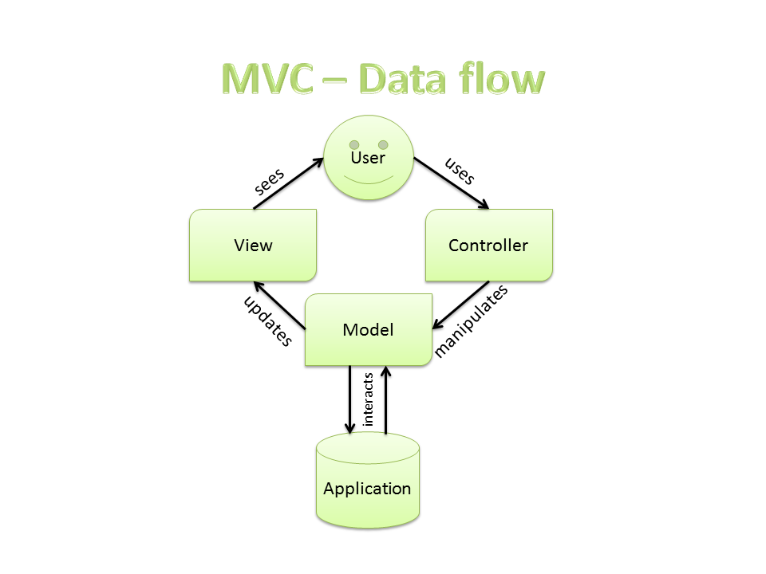
Visual Representation for Data flow of MVC Architecture

Slide 6
Model
Model is the name given to the component that will communicate with the database to manipulate the data.
It acts as a bridge between the View component and the Controller component in the overall architecture.
This is responsible to manage the data.
It stores and retrieves entities used by an application, usually from a database, and contains the logic implemented by the application.

Slide 7
View
The view is responsible to display the data provided by the model in a specific format.
This is responsible for mapping graphics onto a device.
A view attaches to a model and renders its contents to the display surface and formats the data to be presented to the user, in a web application as an html output.

Slide 8
Controller
A controller is the means by which the user interacts with the application.
A controller accepts input from the user and instructs the model and view to perform actions based on that input.
It handles the model and view layers to work together.
The controller receives a request from the client, invokes the model to perform the requested operations and sends the data to the View.
controller is responsible for mapping end-user action to application response.

Slide 9
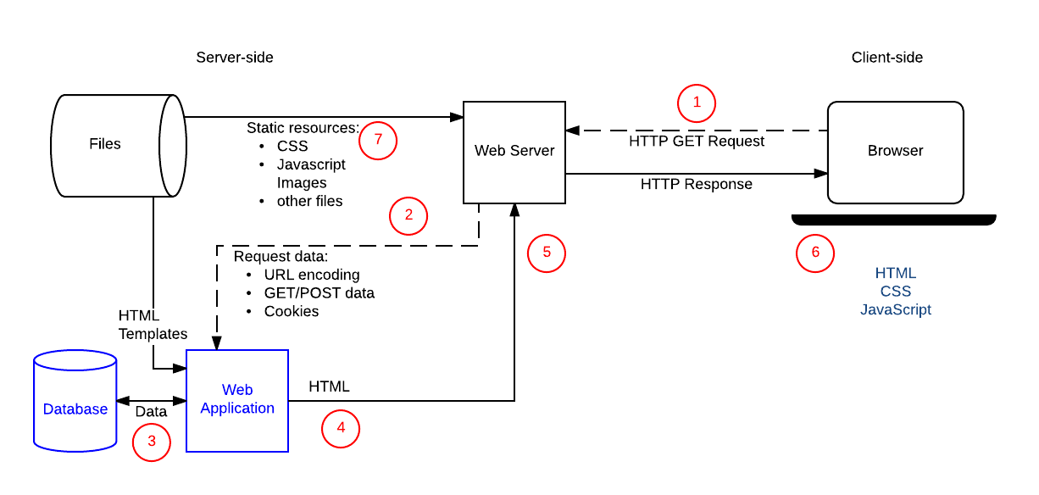
Overview of Web development

Slide 10
Server-side Programming
It is the program that runs on server dealing with the generation of content of web page.
1) Querying the database
2) Operations over databases
3) Access/Write a file on server.
4) Interact with other servers.
5) Structure web applications.
6) Process user input. For example if user input is a text in search box, run a search algorithm on data stored on server and send the results.

Slide 11
Client-side Programming
It is the program that runs on the client machine (browser) and deals with the user interface/display and any other processing that can happen on client machine like reading/writing cookies.
1) Interact with temporary storage
2) Make interactive web pages
3) Interact with local storage
4) Sending request for data to server
5) Send request to server
6) work as an interface between server and user

Slide 12
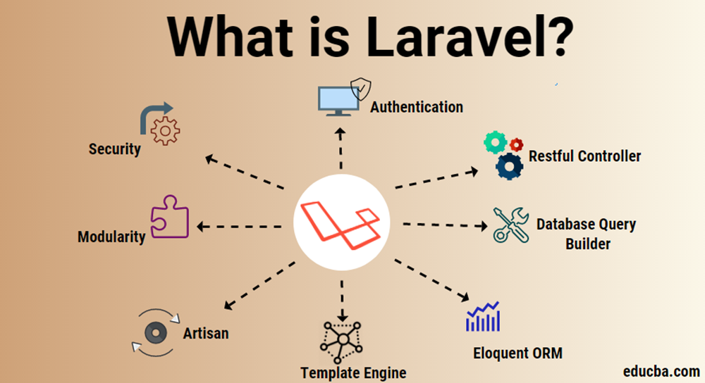
Laravel fundamentals

Slide 13
Installation
In this lesson we will use composer so before trying this you have to install composer and node.
Composer (getcomposer.org)
Getting Started On macOS
Getting Started On Windows
Getting Started On Linux
Choosing Your Sail Services
Installation Via Composer
composer create-project laravel/laravel example-app
cd example-app
php artisan serve

Slide 14
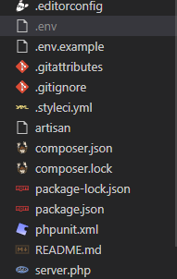
Directory Structure
The app Directory
The bootstrap Directory
The config Directory
The database Directory
The public Directory
The resources Directory
The routes Directory
The storage Directory
The tests Directory
The vendor Directory
Root directories
files

Slide 15
Bootstrap
<!-- Scripts -->
<script src="{{ asset('js/app.js') }}" defer></script>
<!-- Styles -->
<link href="{{ asset('css/app.css') }}" rel="stylesheet">
URL

Slide 16
.env(Database configuration)
DB_CONNECTION=mysql
DB_HOST=127.0.0.1
DB_PORT=3306
DB_DATABASE=laravel8
DB_USERNAME=root
DB_PASSWORD=

Slide 17
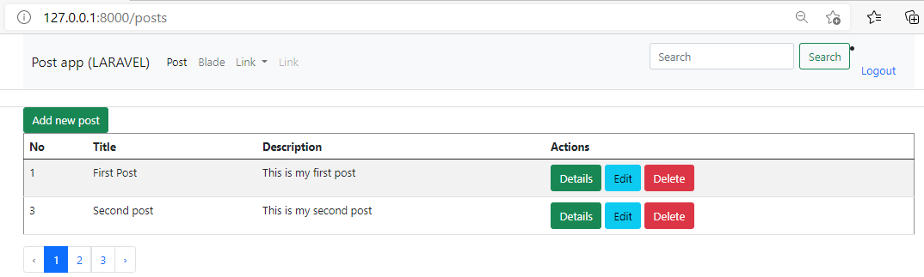
Example : in the following sections will see how to develop such application in Laravel

Slide 18
1.1. Create an object in Model
class Post extends Model
{
protected $table ="posts";
}

Slide 19
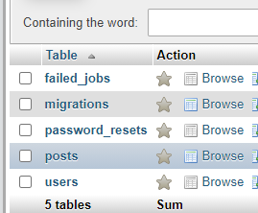
1. Creating model
Create model
php artisan make:model Post -m //creating model and migrate
Database/migrations
public function up()
{ Schema::create(‘posts', function (Blueprint $table) {
$table->id();
$table->string(title');
$table->string(body');
$table->timestamps();
});
}
Add table columns(fields)
php artisan migrate

Slide 20
2. Creating controller
php artisan make:controller PostController

Slide 21
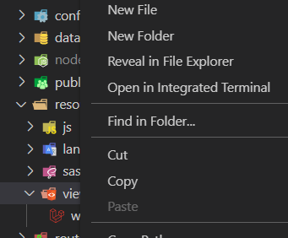
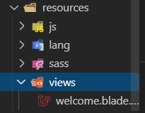

3.1. resources/views/posts.blade.php

Slide 22
4. Call view in controller (PostController)
function allPosts()//this method will called in route
{
return view(‘posts’);//Laravel1/resources/view/posts
}

Slide 23
Set route (routes/web.php)
1st use App\http\controllers\PostController;
2nd Route::get('/posts',[PostController::class,’allPosts']);
View
Method name

Slide 24
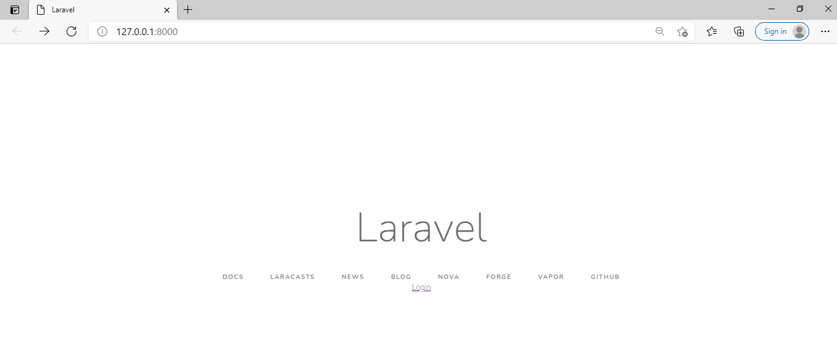
Launch the application(post app)➔view
php artisan serve

Slide 25
Navigation menu(resources/views/layout.blade.php)
<nav class="navbar navbar-expand-lg navbar-light bg-light">
<div class="container-fluid">
<a class="navbar-brand" href="#">Post app (LARAVEL)</a>
<button class="navbar-toggler" type="button" data-bs-toggle="collapse" data-bs-target="#navbarScroll" aria-controls="navbarScroll" aria-expanded="false" aria-label="Toggle navigation">
<span class="navbar-toggler-icon"></span>
</button>
<div class="collapse navbar-collapse" id="navbarScroll">
<ul class="navbar-nav me-auto my-2 my-lg-0 navbar-nav-scroll" style="--bs-scroll-height: 100px;">
<li class="nav-item">
<a class="nav-link active" aria-current="page" href="/posts">Post</a>
</li>

Slide 26
<li class="nav-item">
<a class="nav-link" href="/blade">Blade</a>
</li>
<li class="nav-item dropdown">
<a class="nav-link dropdown-toggle" href="#" id="navbarScrollingDropdown" role="button" data-bs-toggle="dropdown" aria-expanded="false">
Link
</a>
<ul class="dropdown-menu" aria-labelledby="navbarScrollingDropdown">
<li><a class="dropdown-item" href="#">Action</a></li>
<li><a class="dropdown-item" href="#">Another action</a></li>
<li><hr class="dropdown-divider"></li>
<li><a class="dropdown-item" href="#">Something else here</a></li>
</ul>
</li>

Slide 27
<li class="nav-item">
<a class="nav-link disabled" href="#" tabindex="-1" aria-disabled="true">Link</a>
</li>
</ul>
<form class="d-flex">
<input class="form-control me-2" type="search" placeholder="Search" aria-label="Search">
<button class="btn btn-outline-success" type="submit">Search</button>
</form>
<li class="nav-item">
<a class="nav-link" href="/">Logout</a>
</li>
</div>
</div>
</nav>

Slide 28
Include in another pages(header)posts.blade.php
@include('layout')

Slide 29
Footer (resources/views/footer.blade.php)
<footer class="text-center text-white fixed-bottom" style="background-color: #21081a;">
<!-- Grid container -->
<div class="container p-4"></div>
<!-- Grid container -->
<!-- Copyright -->
<div class="text-center p-3" style="background-color: rgba(0, 0, 0, 0.2);">
© 2020 Copyright:
</div>
<!-- Copyright -->
</footer>
</body>
</html>

Slide 30
Include footer in another pages(posts.blade.php)
@include(‘footer’)

Slide 31
Create post button
1st <a href="/addPost" class="btn btn-success">Add new post</a>
2nd Route::get('/addPost',[PostController::class,'addPostView’]);
Create method than can render add post view
3rd function addPostView(){
return view('add-post');
}

Slide 32
4th view (resources/views/add-post.blade.php)
5th Route::post('create-post',[PostController::class,'createPost'])->name('post.create');
<form action="{{ route('post.create') }}" method="post">
@csrf
<label for="title">Title</label>
<input type="text" name="title" id="" class="form-control">
<br>
<br>
<label for="body">Body</label>
<textarea name="body" id="" cols="30" rows="10"></textarea>
<br>
<input type="submit" value="Save">
</form>

Slide 33
Last of add button
use App\Post;//in PostController page
6th
function createPost(Request $req){
$post = new Post();
$post->title = $req->title;
$post->body = $req->body;
$post->save();
return redirect('posts');
}

Slide 34
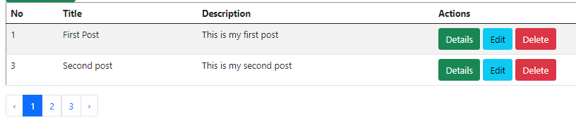
Fetch from DB (method in controller)
1st
public function getPosts()
{
/*
$posts = Post::orderBy('id','DESC')->get();
return view('posts',compact('posts'));
*/
$posts = Post::paginate(2);
return view('posts',['posts'=>$posts]);
}
2nd Route::get('/posts',[PostController::class,'getPosts']);

Slide 35
3rd View (resources/views/posts.blade.php)
<tbody>
@foreach($posts as $post)
<tr>
<td> {{ $post->id }}</td>
<td> {{ $post->title }}</td>
<td> {{ $post->body }}</td>
<td>
<a href="/posts{{ $post->id }}" >Details</a>
<a href="/edit-post{{$post->id }}" >Edit</a>
<a href="/delete-post{{ $post->id }}" >Delete</a>
</td>
</tr>
@endforeach
</tbody>
Actions

Slide 36

Details
1st Method (in PostController)
public function getPostById($id)
{
$post = Post:: where('id',$id)->first();
return view('single-post',compact('post'));
}
2nd Route (in routes/web.php)
Route::get('/posts{id}',[PostController::class,'getPostById']);

Slide 37
Details view (resources/views/single-post.blade.php)
@include('layout')
<div class="container p-3 my-3 bg-primary text-white">
{{ $post->title }}
<br>
{{ $post->body }}
</div>
@include('footer');

Slide 38

Edit
1st Method
public function editPost($id)
{
$post = Post::find($id);
return view('edit-post',compact('post'));
}
2nd Route
Route::get('/edit-post{id}',[PostController::class,'editPost']);

Slide 39
3rd Form (fetch data for update)(edit-post.blade.php)
<form action="{{ route('post.update') }}" method="post">
@csrf
<input type="hidden" name="id" value="{{ $post->id }}">
<div class="form-group">
<label for="title">Post Title</label>
</div>
<div class="form-group">
<input type="text" name="title" id="" class="form-controll" placeholder="Enter post title" value="{{ $post->title }}">
</div>
<div class="form-group">
<label for="bodt">Post Description</label>
</div>
<div class="form-group">
<textarea name="body" id="" rows="3" class="form-controll"> {{ $post->body }}</textarea>
</div>
<button type="submit" class="btn btn-success">Update post</button>
</form>

Slide 40
Action method of form for update
1st Method
public function updatePost(Request $request)
{
$post = Post::find($request->id);
$post->title = $request->title;
$post->body = $request->body;
$post->save();
return redirect('posts');
}
2nd Route
Route::post('/update-post',[PostController::class,'updatePost'])->name('post.update');

Slide 41
Delete
<a href="/delete-post{{ $post->id }}" class='btn btn-danger’ onclick="return confirm('Are you sure?')">Delete</a>
1st Method
public function deletePost($id)
{
Post:: where('id',$id)->delete();
return redirect('posts');
}
2nd Route
Route::get('/delete-post{id}',[PostController::class,'deletePost']);

Slide 42
Blade
1st controller
php artisan make:controller BladeController
2nd method
function aboutBalde()
{
$name = "Abebe Kebede";
$age =28;
$x =5;
$y =2;
return view('bl',compact('name','age','x','y'));
}

Slide 43
Blade view(resources/views/bl.blade.php)
{{ $name }} is {{ $age }} old.
@if ($age <=30)
he is young
@elseif($age <=50)
he is an adult
@else
he is old
@endif
<br>
x = {{ $x }} and y ={{ $y }}
<br>
{{ $x }} + {{ $y }} = {{ $x + $y }}

Slide 44
To sum-up
Seen about :
Create model and migrate
Create controller and make communication of model and view(route)
Eloquent methods
Create menu and include when needed
Blade template engine

Slide 45
Your Project
You have submitted Model. So implement it as seen above and add the following features
Advanced featured data table (sort, live search, export in different format)
Authentication
Localization
Relationship(you submitted a model but if you have time better to create more than one model and manipulate based on relationship rule)
Every members must participate through git collaboration

Slide 46
Reference and source code
Installation - Laravel - The PHP Framework For Web Artisans
https://php-html.net/tutorials/model-view-controller-in-php/
https://www.studentstutorial.com/php/mvc/intro
https://www.sitepoint.com/the-mvc-pattern-and-php-1/
https://github.com/DBUCS2013/Laravel-Web-App

